Slide 1
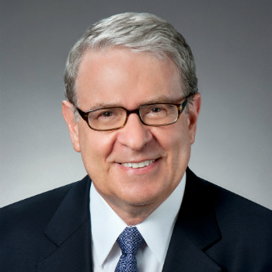
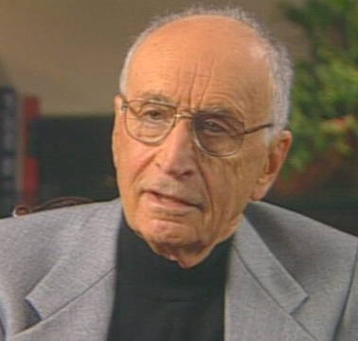
Vertical integration, appropriable rents, and the competitive contracting process
Klein, Crawford, and Alchian (1978)
Journal of Law and Economics
Modified & Presented by Carter Zagorski
BADM 549

Slide 2
Main Purpose
Previous literature: Coase Theorem
Posits that transaction, coordination, and contracting costs must be considered explicitly – explains the extent of vertical integration.
This insight forced economists to begin looking for previously neglected constraints on the trading process that might efficiently lead to an intrafirm rather than an interfirm transaction.
This paper: Explores the possibility of post-contractual opportunistic behavior.
Notes:
Vertical integration occurs due to the high cost of spot contracts: transaction costs.

Slide 3
Theory Setting
Conditions: The presence of appropriable specialized quasi rents
Problem: Specific investment is made, and such quasi rents are created → (potential) opportunistic behavior
Solution:
vertical integration
(long-term) contracts
Assumptions: As assets become more specific and more appropriable quasi rents are created (and therefore the possible gains from opportunistic behavior increases), the costs of contracting will generally increase more than the costs of vertical integration
Outcome: More likely to observe vertical integration

Slide 4
Quasi rent
Definition: The excess of its value over its salvage value, that is, its value in its next best use to another renter.
Example:
Operating costs: $1,500
Salvageable value: $1,000
(a) Printing Press Owner A: Contracted rate of $5,500 with Publisher B (better for A)
(b) or: Contracted rate of $3,500 with Publisher C (worse for A)
Quasi Rent of (a): 5,500 – 1,500 – 1,000 = 3,000
Quasi Rent of (b): 3,500 – 1,500 – 1,000 = 1,000
Appropriable quasi-rent is $2,000, which is the source of the economic holdup problem.

Slide 5
Post-Contractual Opportunism
Reason for vertical integration: the avoidance of post-contractual opportunistic behavior when specialized assets and appropriable quasi rents are present
Post-contractual opportunism:
Antecedents: relative bargaining power, incomplete contracts
Consequences: unanticipated non-fulfillment of the contract, a loss of efficiency

Slide 6
Contractual Solution
An alternative to vertical integration as a solution to the general problem of opportunistic behavior
Long-term Contracts:
Explicit long-term contracts (enforced by the government or some other outside institution): costly
Implicit long-term contracts (enforced by the market mechanism of withdrawing future business if opportunistic behavior occurs): This goodwill market-enforcement mechanism undoubtedly is a major element of the contractual alternative to vertical integration.
Low appropriable specialized quasi rents | High appropriable specialized quasi rents
contractual relationship > vertical integration | vertical integration > contractual relationship

Slide 7
Conclusions
Assumption: “As assets become more specific and more appropriable quasi rents are created, the costs of contracting will generally increase more than the costs of vertical integration. Hence, ceteris paribus, we are more likely to observe vertical integration.”
Premiums in Contracts: Offering cheaters premiums (prices greater than average variable cost, exceeding potential gain from cheating) eliminates systematic opportunistic behavior. Thus, both parties ”know exactly when and how much a contract will be broken” – making an unanticipated broken contract “not possible.”
Behavior: Firms often rely upon long-term implicit contracts when “government enforcement of contracts is weaker.”

Slide 8
Some Examples
Examples | Context (Specialized Assets) | Potential Opportunistic Behaviors | Solution
Automobile Manufacturing | GM-Fisher Body A ten-year contract: GE agreed to buy all its closed metal bodies from Fisher at a price set on a cost plus 17.6 per cent basis) Unexpected soar in demand for closed metal bodies → GE was very unhappy with the high price Fisher Body refused to locate their body plants adjacent to GE | Fisher Body Demanded a monopoly price for the bodies Refused to adjust the price and relocate to places close to GE | Vertical integration: GM-Fisher merged
Petroleum Industry | Oil refineries and oil-producing properties are specialized to oil pipelines | Pipeline owner Buys all crude oil at low cost and sell it to refineries at a much higher price | Jointly owned company: Owns the pipeline with the shares by producers and refiners in the pipeline firms corresponding to the respective shares of oil to be transported

Slide 9
Some Examples –Cont.
Examples | Context (Specialized Assets) | Potential Opportunistic Behaviors |  |  | Solution
 |  | A | B | C
Agricultural Industry . | Peach orchard: Laborers pick ripened peaches * Specific Human Capital: Law prohibiting slavery → explicit or implicit contract rather than vertical integration | Labor Union Laborer becomes a member of labor union and refuses to pick peaches unless get paid more. Labor Union has the ability to exclude other laborers to extract monopoly and quasi rents | Firm Cheat in the last period: transient employee | Employee The employee threatens to quit after the firm makes the specific investment unless the wage rate is readjusted upward | A. Farmers use implicit contract: Brand-name capital of the union (to increase the cost to the union of opportunistic behavior) B. Union can employ long-term contract and even strike threat to punish a firm that violates the contract C. Union can withhold employees’ pension rights
Leasing Inputs and Ownership of the Firm | Transportation: American steam locomotives were highly specialized Agricultural land for annual crops Brand name | Land-owner Credible post-contractual opportunistic threats by the landowner are not possible due to easiness of monitoring contract terms But if: Landowner can vary the quality of the land by controlling the irrigation system to the crops or the electricity supply to a building | Franchisee (renter) May be less likely to build up goodwill. May depreciate a valuable rented brand name | Leasing company (franchisor) Increases the rental fee for the trade name | A. Vertical integration B. Close to vertical integration: direct controls are placed on franchisee behavior

Slide 10
Some Examples – Cont.
Examples | Context (Specialized Assets) | Potential Opportunistic Behaviors |  | Solution
 |  | Party A The owner is not a member: | Party B The owner are members:
Social Institutions: Golf country club | Friendship (intangible assets) in mutual ownership: some golf courses are operated with very few social activities for the set of members and their families | Country club owner Once the membership value is created by the interpersonal activities of the members, the owner of the club could then start to raise the fees for continuing members The owner could threaten to break the implicit contract and destroy some of the sociability capital by selling admission to "undesirable" people who want to consort with the existing members | Member Threatens to sell to an "undesirable" potential member, extract some value of congeniality from the current members, as a payment for not selling | Government arbitration or intervention

Slide 11
Discussion
Conclusion
It is useful to merely examine the economic rationale for different types of contractual relationships in particular situations and consider the firm as a particular kind or set of interrelated contracts.
Discussion Questions and Critique:
From this article, the authors discuss multiple cases of post-contractual opportunistic behaviors that can result from investment in specialized assets. Does this mean that trust between the two parties will decrease as the degree of asset specificity increases?
Society seems better off with an efficient marketplace which can be developed via applications of the principles of this paper. To what extent do governments have a responsibility, if at all, to both parties to a contract as well as the parties’ beneficiaries, to organize and enforce regulations on this topic vs. rely on an implicit, “invisible hand” approach?
It seems like this paper focuses mostly on transaction costs and neglects the internal organizing costs that may increase after vertical integration.

